Slide 1
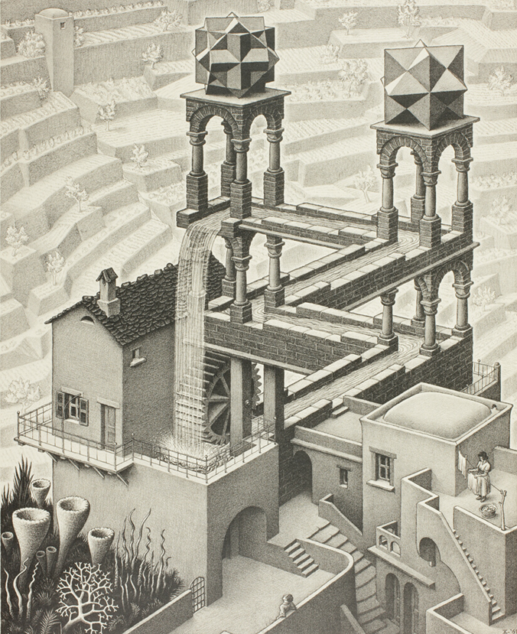

From linear to circular – 2/2
IL “Introduction to Circular Economy” WS 24-25
Kami Höferl
(Escher, 1961)

Slide 2
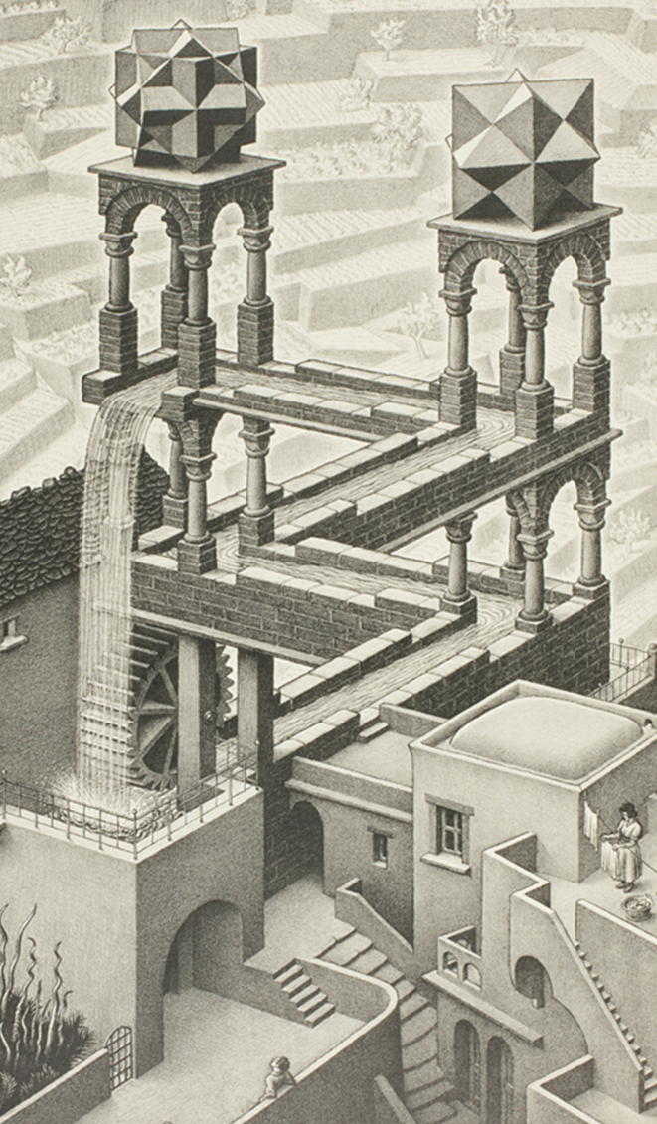
Overview
Me & my phone
Defining Circular Economy (Arrrrrr!)
Again my phone
Some reflections
(Escher, 1961)
(Escher, 1961)

Slide 3
& now: Circular Economy?

Slide 4
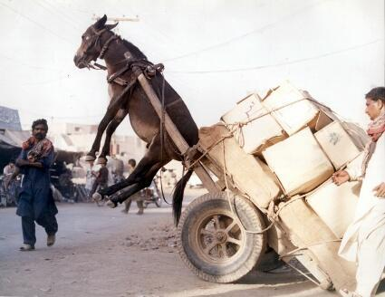
💡Ecological carrying capacity (aka: there are limits)

Slide 5
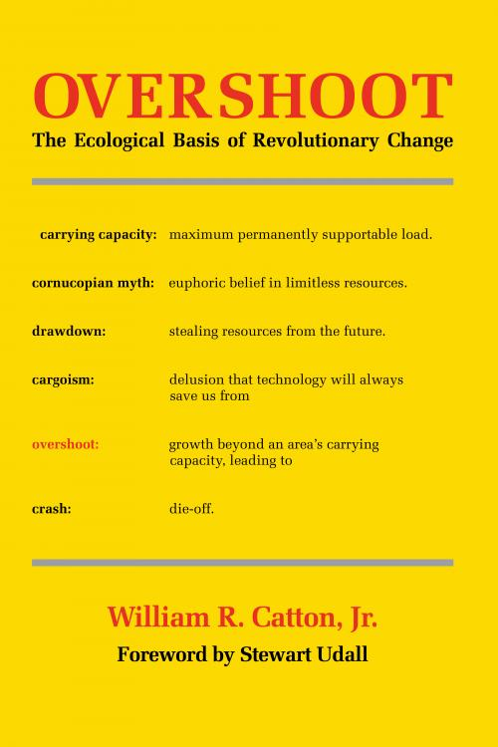


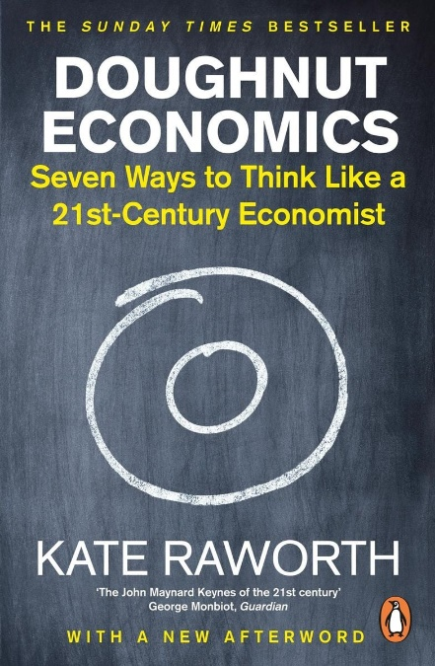
Reviewing our socio-ecological performance from an earth-systems perspective
Notes:
1980: Catton – AUT 07.04 (Rückgang von Dez in 1961)
1997: Schmidt Bleek
1996: Weizäcker: Faktor 4
1996: Wackernackel
2017: donought economics Kate Raworth
Linear Economy: Take – make – Waste Approach

Slide 6
Earth-Systems Perspective?
Holistic approach: Earth = interconnected system
atmosphere, hydrosphere, biosphere, lithosphere, anthroposphere
Dynamic interactions:
processes, feedback loops, and thresholds influencing system stability
positive (amplifying) and negative (stabilising) feedbacks
Planetary boundaries: safe operating limits for Earth’s systems
climate, biodiversity, etc.
Temporal and spatial scales
processes from local to global and short to geological timescales
Interdisciplinarity: insights from natural and social sciences to understand complex interactions
Human Role: humans = dominant geological force 👉 Anthropocene
Focus on resilience: system capacity to absorb disturbances and adapt to change

Slide 7
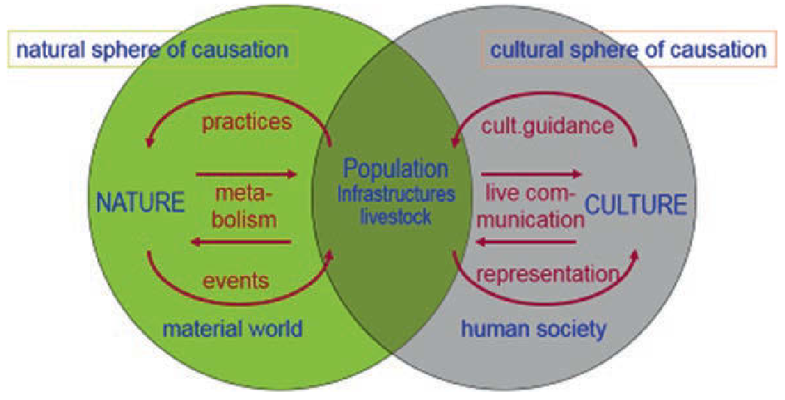
Understanding society as hybrid system (e.g. Fischer-Kowalski and Weisz 1999)

Slide 8

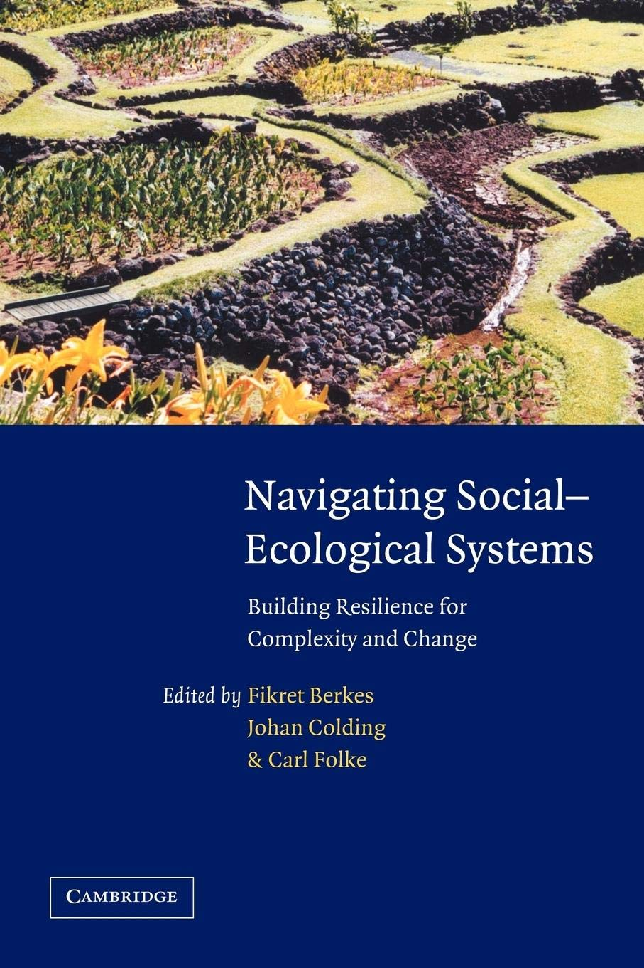
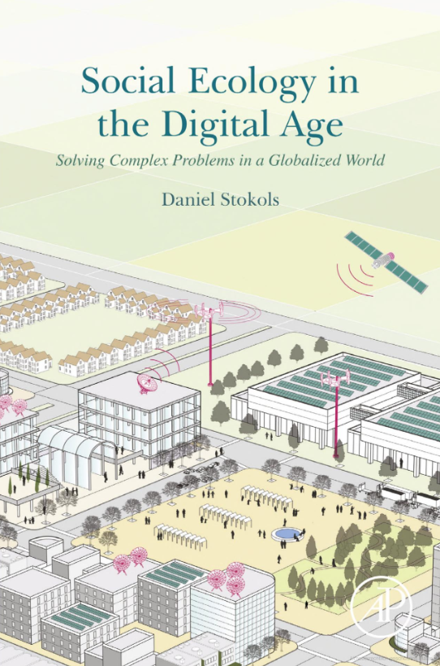
Understanding society as hybrid system (e.g. Fischer-Kowalski and Weisz 1999)

Slide 9
The Vienna School of Socio Ecology (~ 1990)
Interdisciplinary Approach:
natural sciences, social sciences, and humanities 👉 study human-environment interactions
Socio-Metabolic Perspective:
how societies consume energy and materials to sustain themselves 👉 "social metabolism"
Focus on the impacts of material and energy flows on ecosystems
Long-Term Sustainability:
historical trends in resource use and their implications for future sustainability
Advocates for systemic change to reduce ecological footprints and transition to sustainable practices
Notes:
Societies are seen as systems that rely on inputs (resources) and produce outputs (waste).
The school emphasizes reducing these flows to sustainable levels.

Slide 10
Key concepts in a socio-ecological perspective:
Socio-Ecological Transitions:
How societies have transitioned through phases like industrialisation
what is required for a shift to sustainability
how to achieve a "low-carbon" or "circular" economy
Human-Environment Systems:
social and ecological systems = deeply intertwined and co-evolving
changes in one system inevitably affect the other

Slide 11
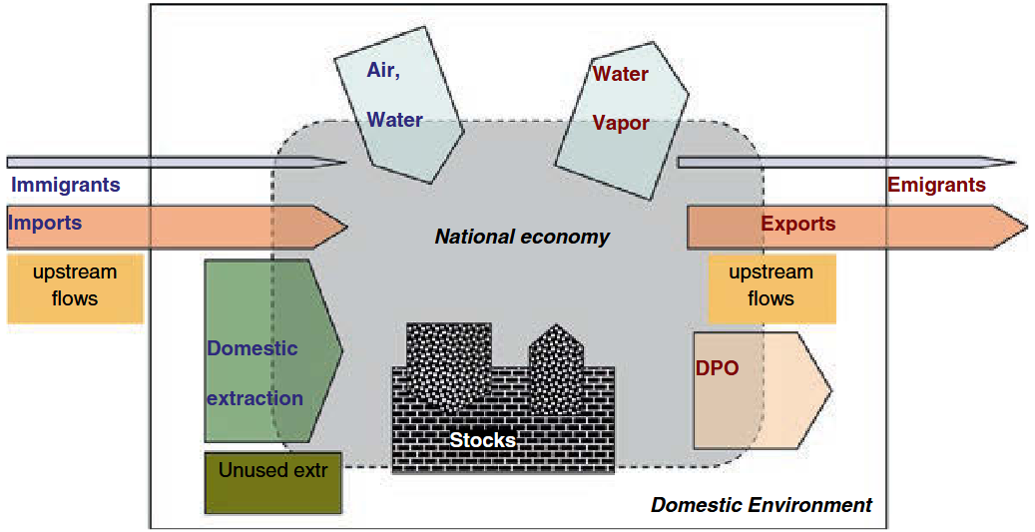
@ Metabolism:
(direct) energy
Notes:
DPO: domestic processed outputs - wastes, emissions, dissipatively used materials and deliberate deposition

Slide 12
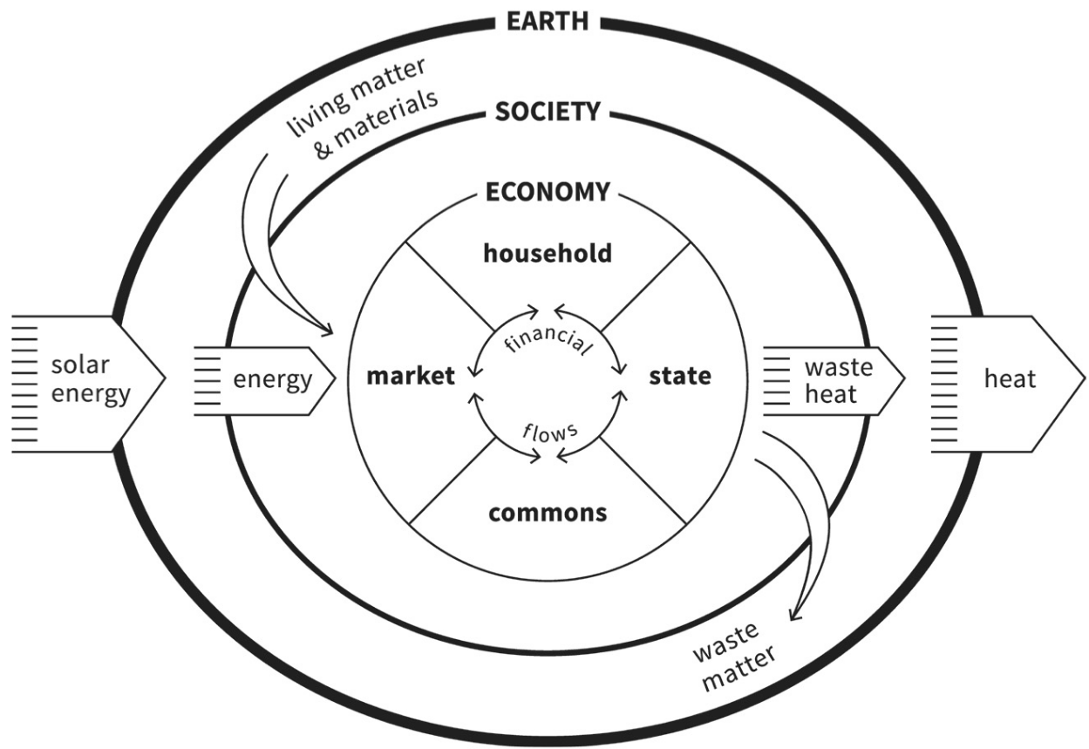
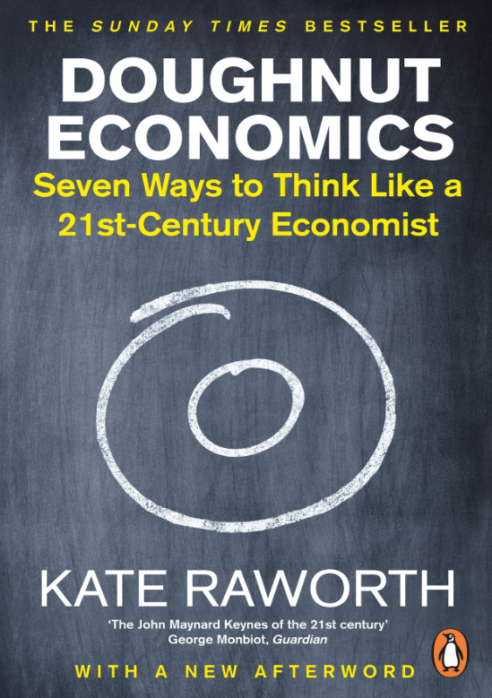
To sum it up: We’ve come a long way

Slide 13
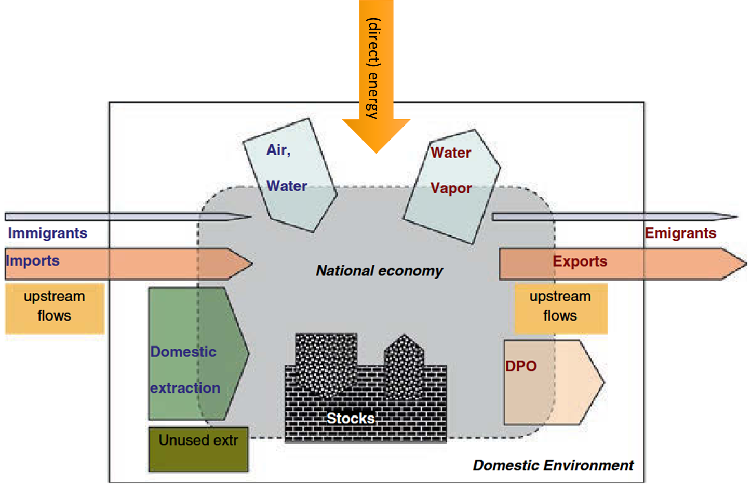
To sum it up: We’ve come a long way

Slide 14
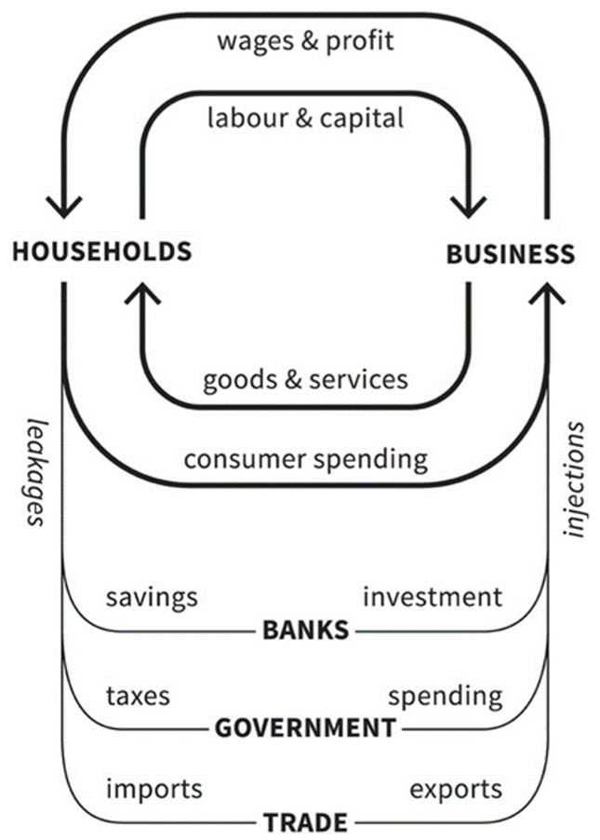
Metabolic vs. isolated perspective on economy
(direct) energy
Notes:
DPO: domestic processed outputs - wastes, emissions, dissipatively used materials and deliberate deposition
Rechts: Self-contained markets

Slide 15
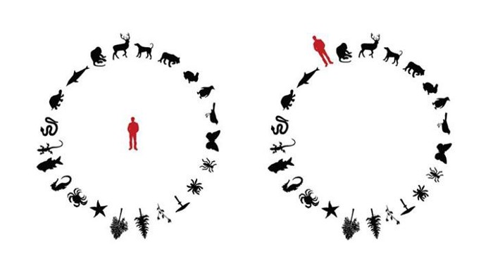
A fundamental shift in perspective:

Slide 16
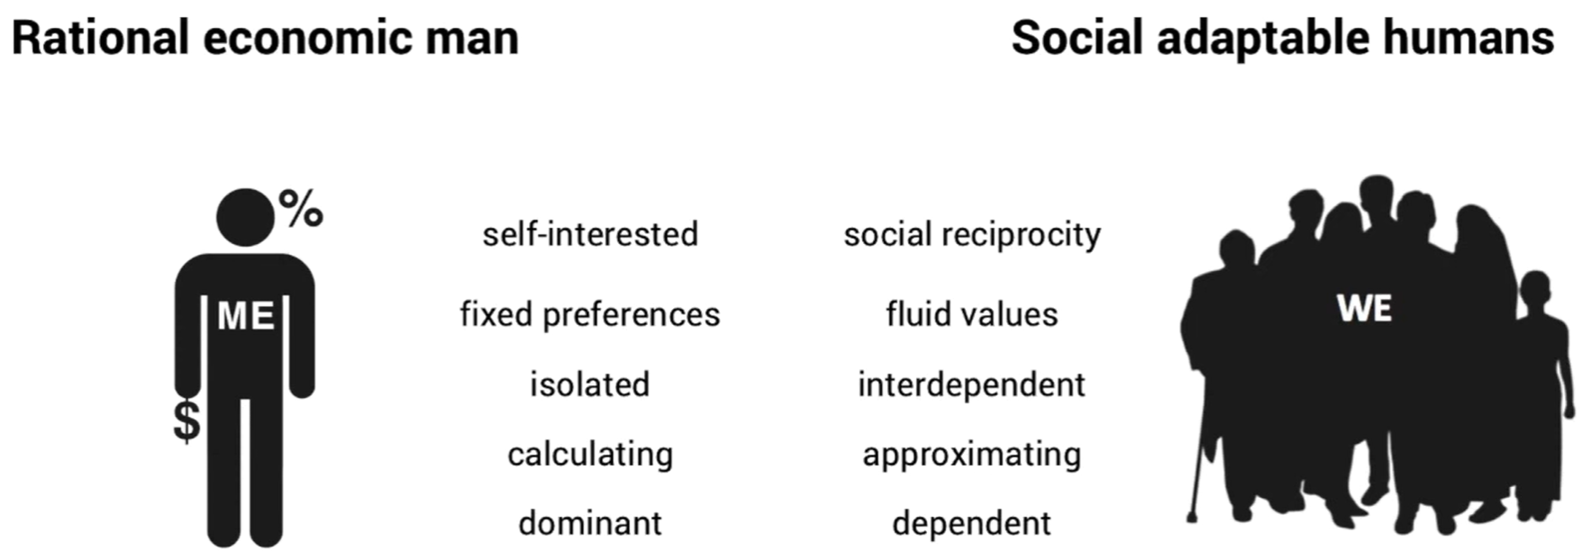
A fundamental shift in perspective:

Slide 17
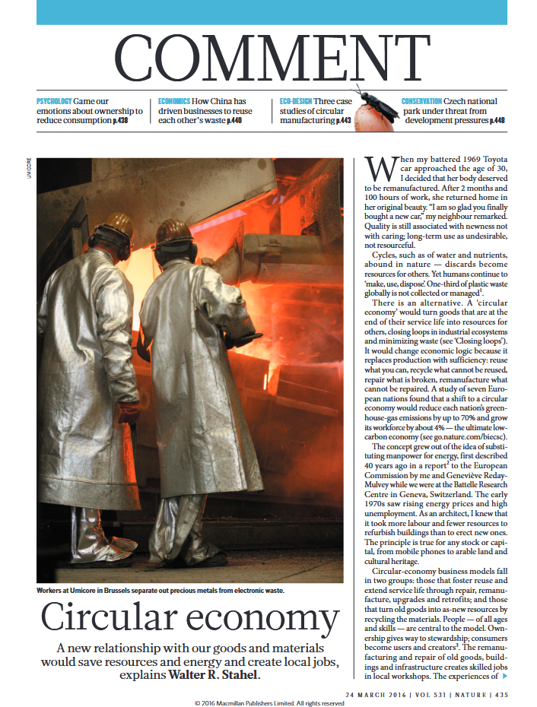
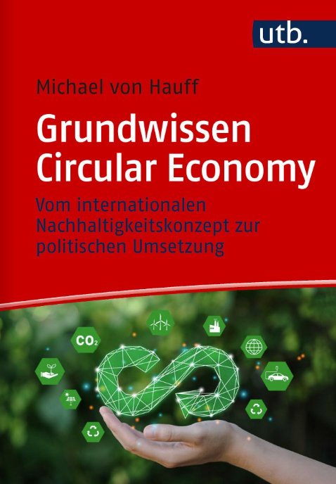
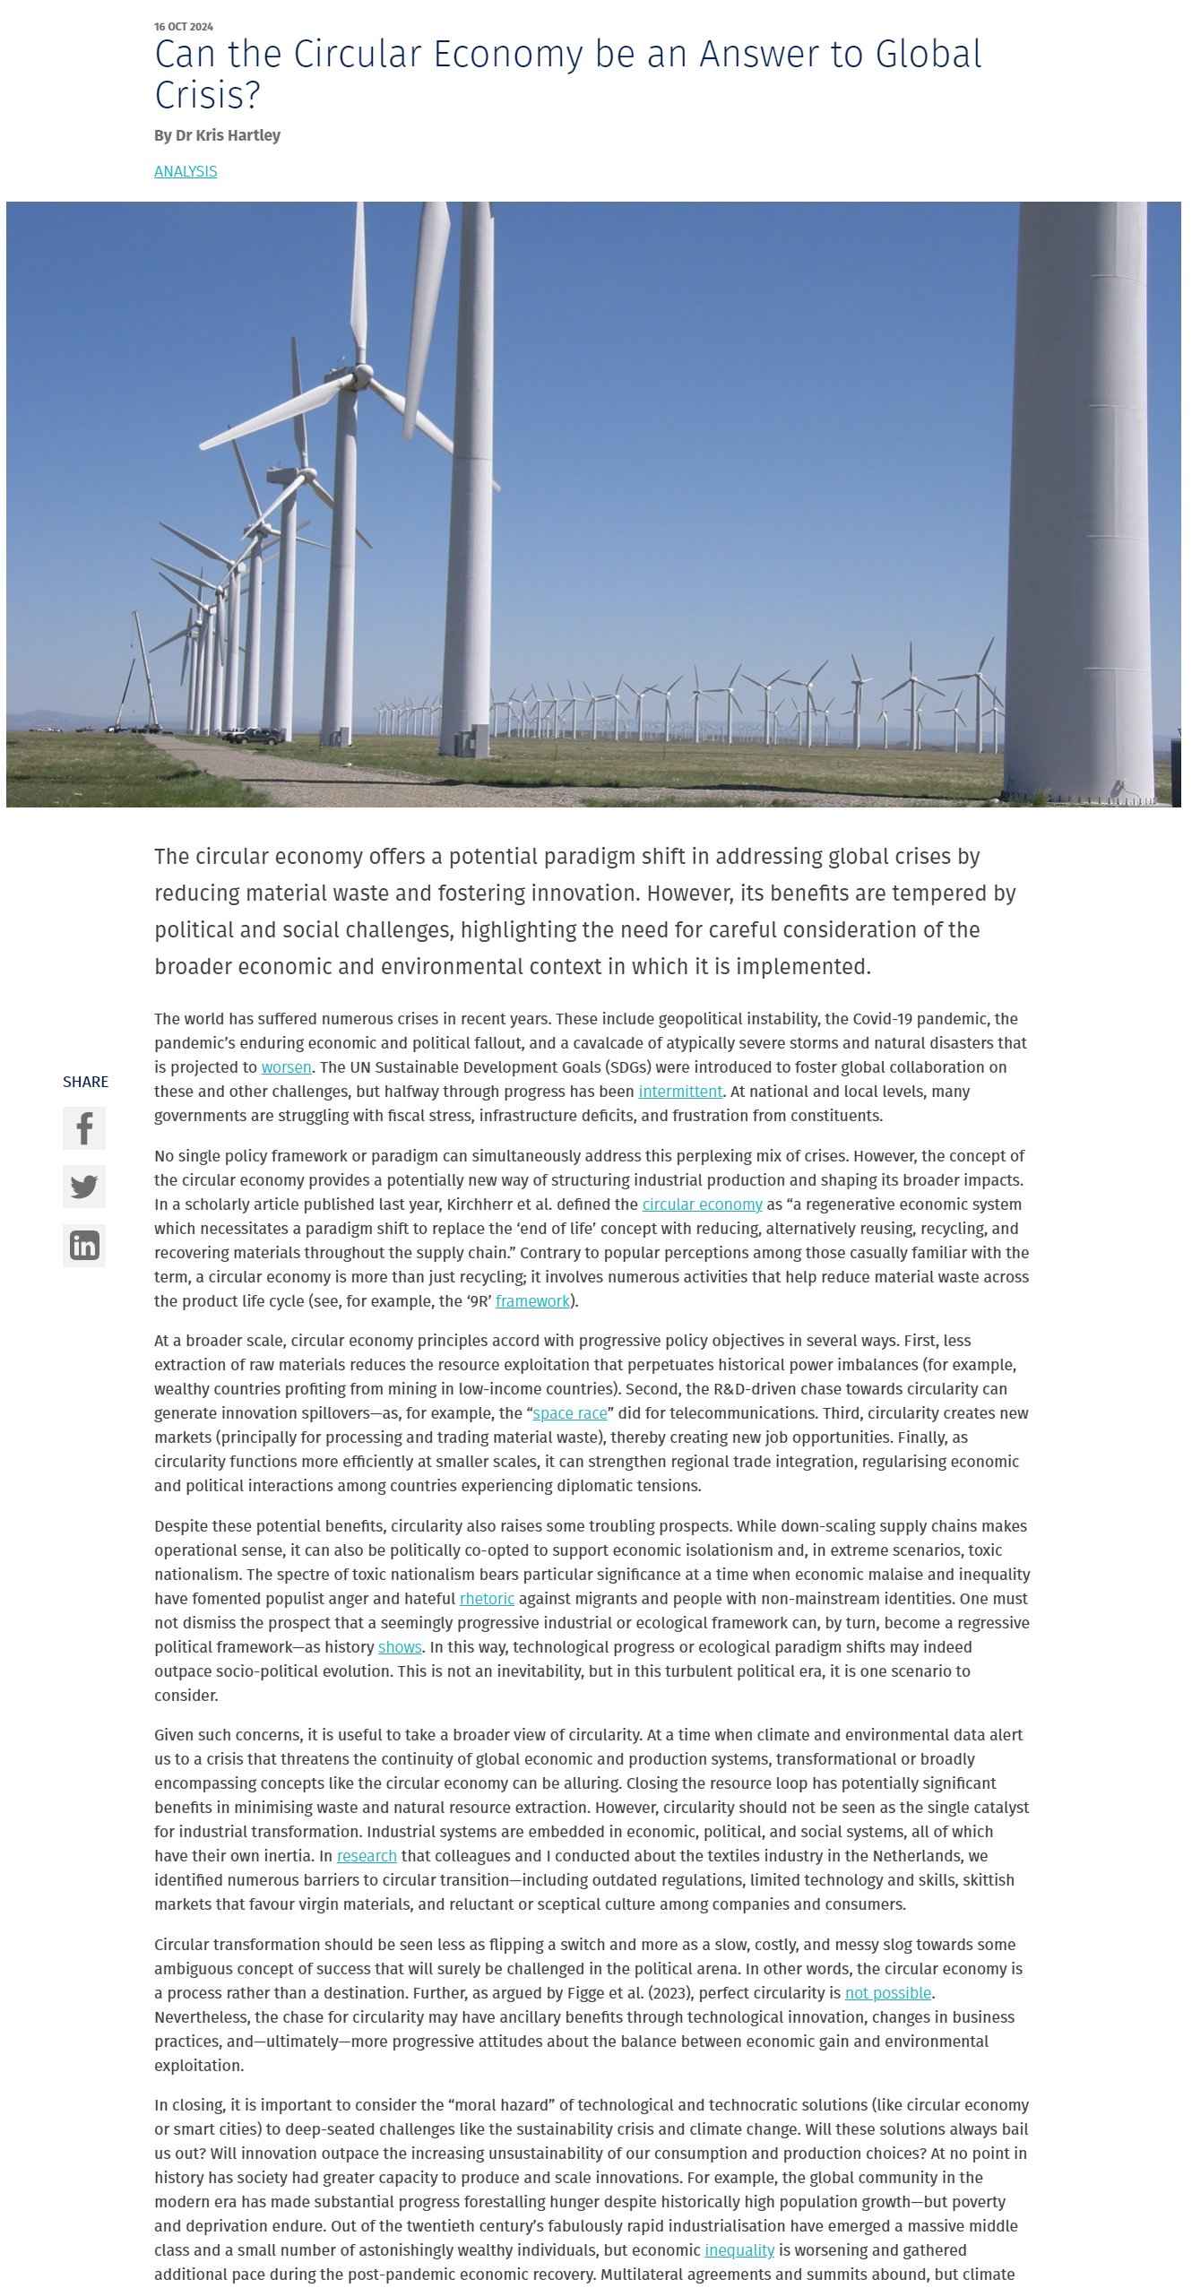
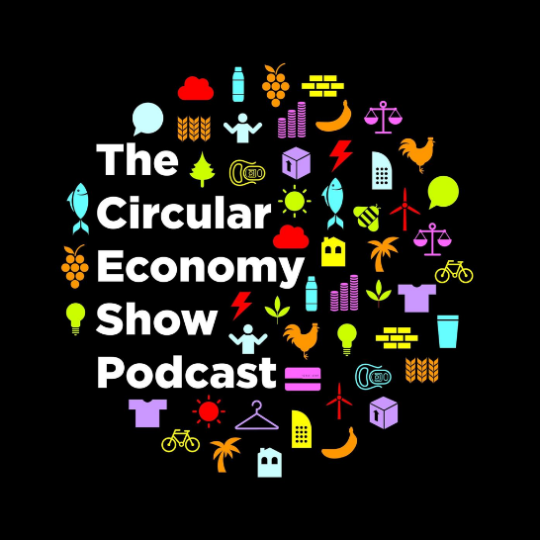
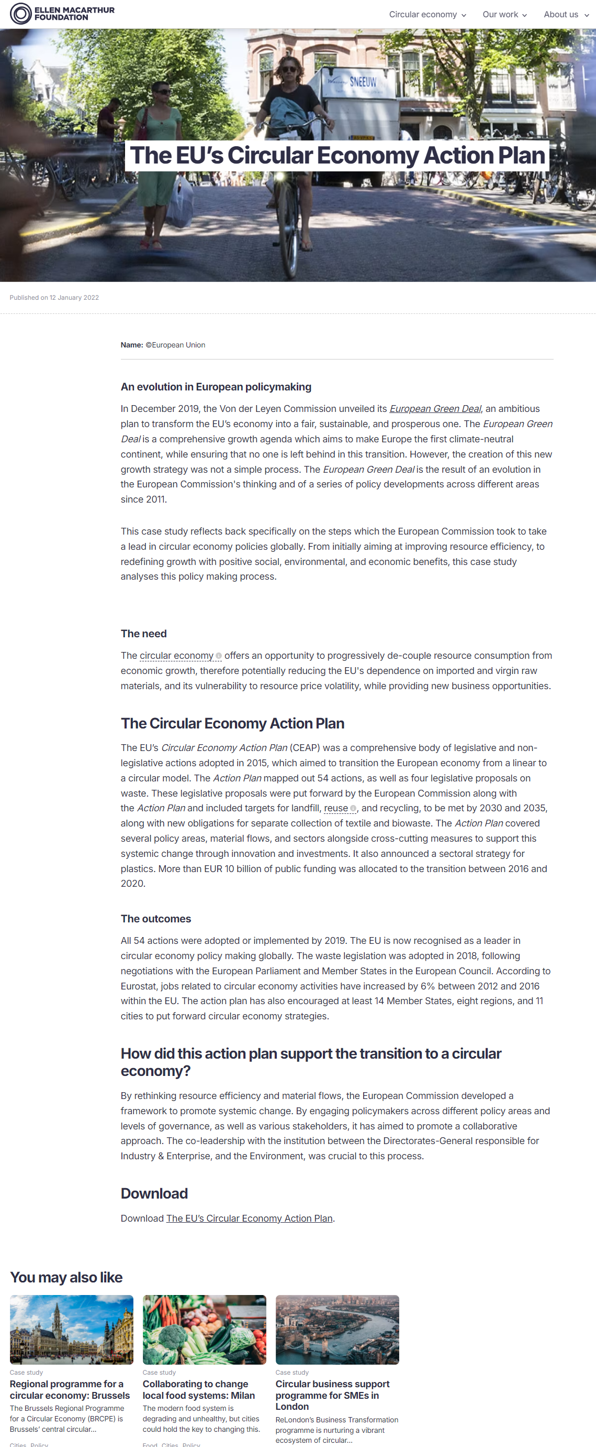
From linear to circular strategies:

Slide 18
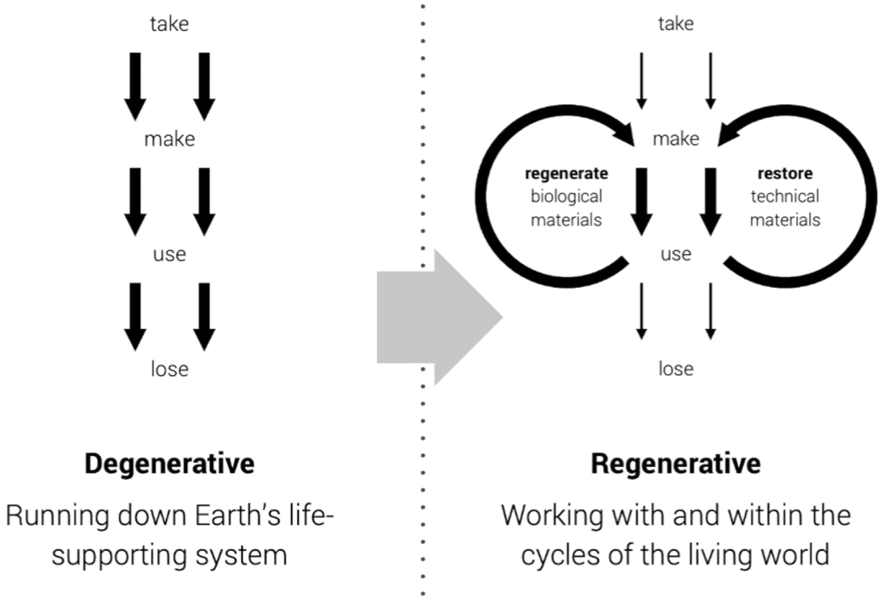
From linear to circular strategies:

Slide 19
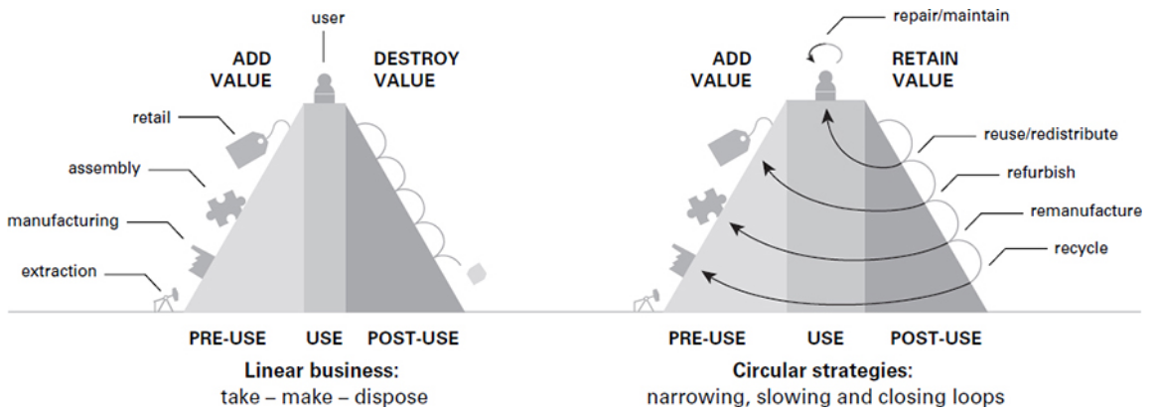
From linear to circular strategies:

Slide 20
BREAK

Slide 21
Defining circular economy

Slide 22
How to define “Circular Economy”?
🤔

Slide 23
Walter Stahel’s (2016) Plea for a “Circular Economy”

Slide 24
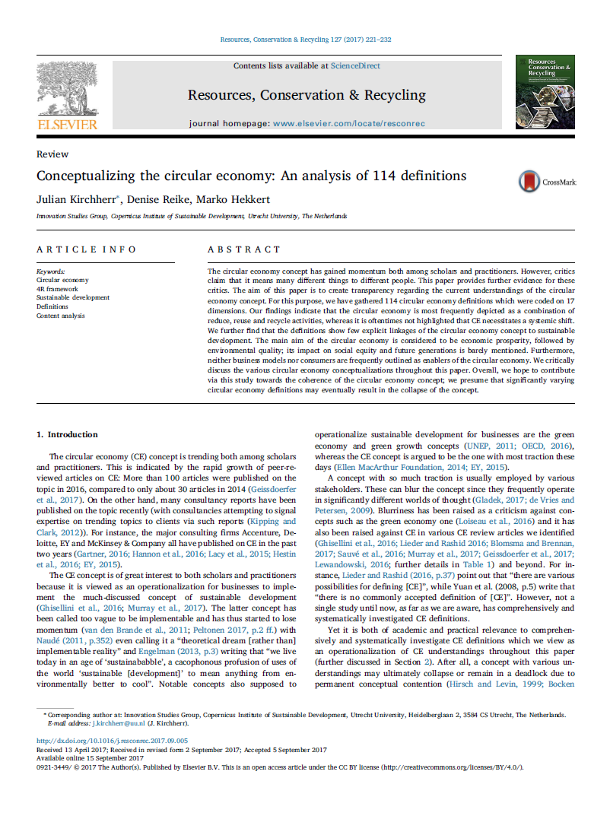
A “definitional quagmire” (Corvellec et al., 2022:2):

Slide 25

Despite the “definitional quagmire”:
👉 Umbrella concept:
“an economic system that seeks to eliminate waste and pollution, circulate products and materials at their highest value, and regenerate nature.“ (EllenMacArthur Foundation, 2023)
“A model of production and consumption that emphasizes sharing, leasing, reusing, repairing, refurbishing, and recycling materials and products for as long as possible. “(EU Commission, 2022)
“a system enabling social progress, preservation of natural capital, and economic development. Its goal is to decouple economic growth from resource depletion by fostering innovative products, services, and business models that optimize resource use throughout the product lifecycle“ (United Nations, n.y.)
Notes:
Linear: Take – make – waste
80% environmental impact from insufficient design (EC, 2020:3)
Walter Stahel: 1982 „closed loop economy“
2013: Ellen MacArthur Foundation Vol. 1
3R: 2008 Circular Economy Promotion Law of the People’s Republic of China

Slide 26
Despite the “definitional quagmire”:
Umbrella concept: “economic system that replaces the ‘end-of-life’ concept with reducing, alternatively reusing, recycling & recovering materials in production /distribution & consumption processes.” (Kirchherr, 2017:224)
Notes:
MacArthur:
Eliminate waste & pollution
Circulate products & materials (at their highest value)
Regenerate Nature

Slide 27
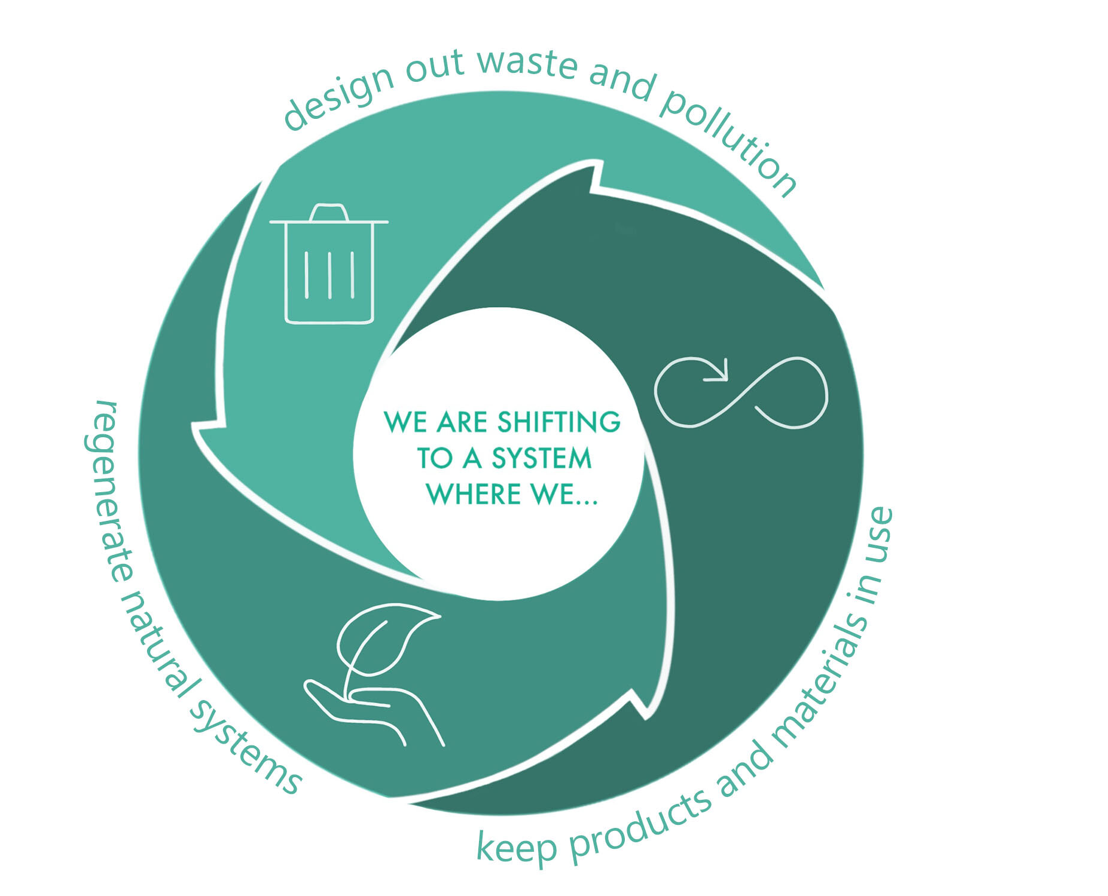
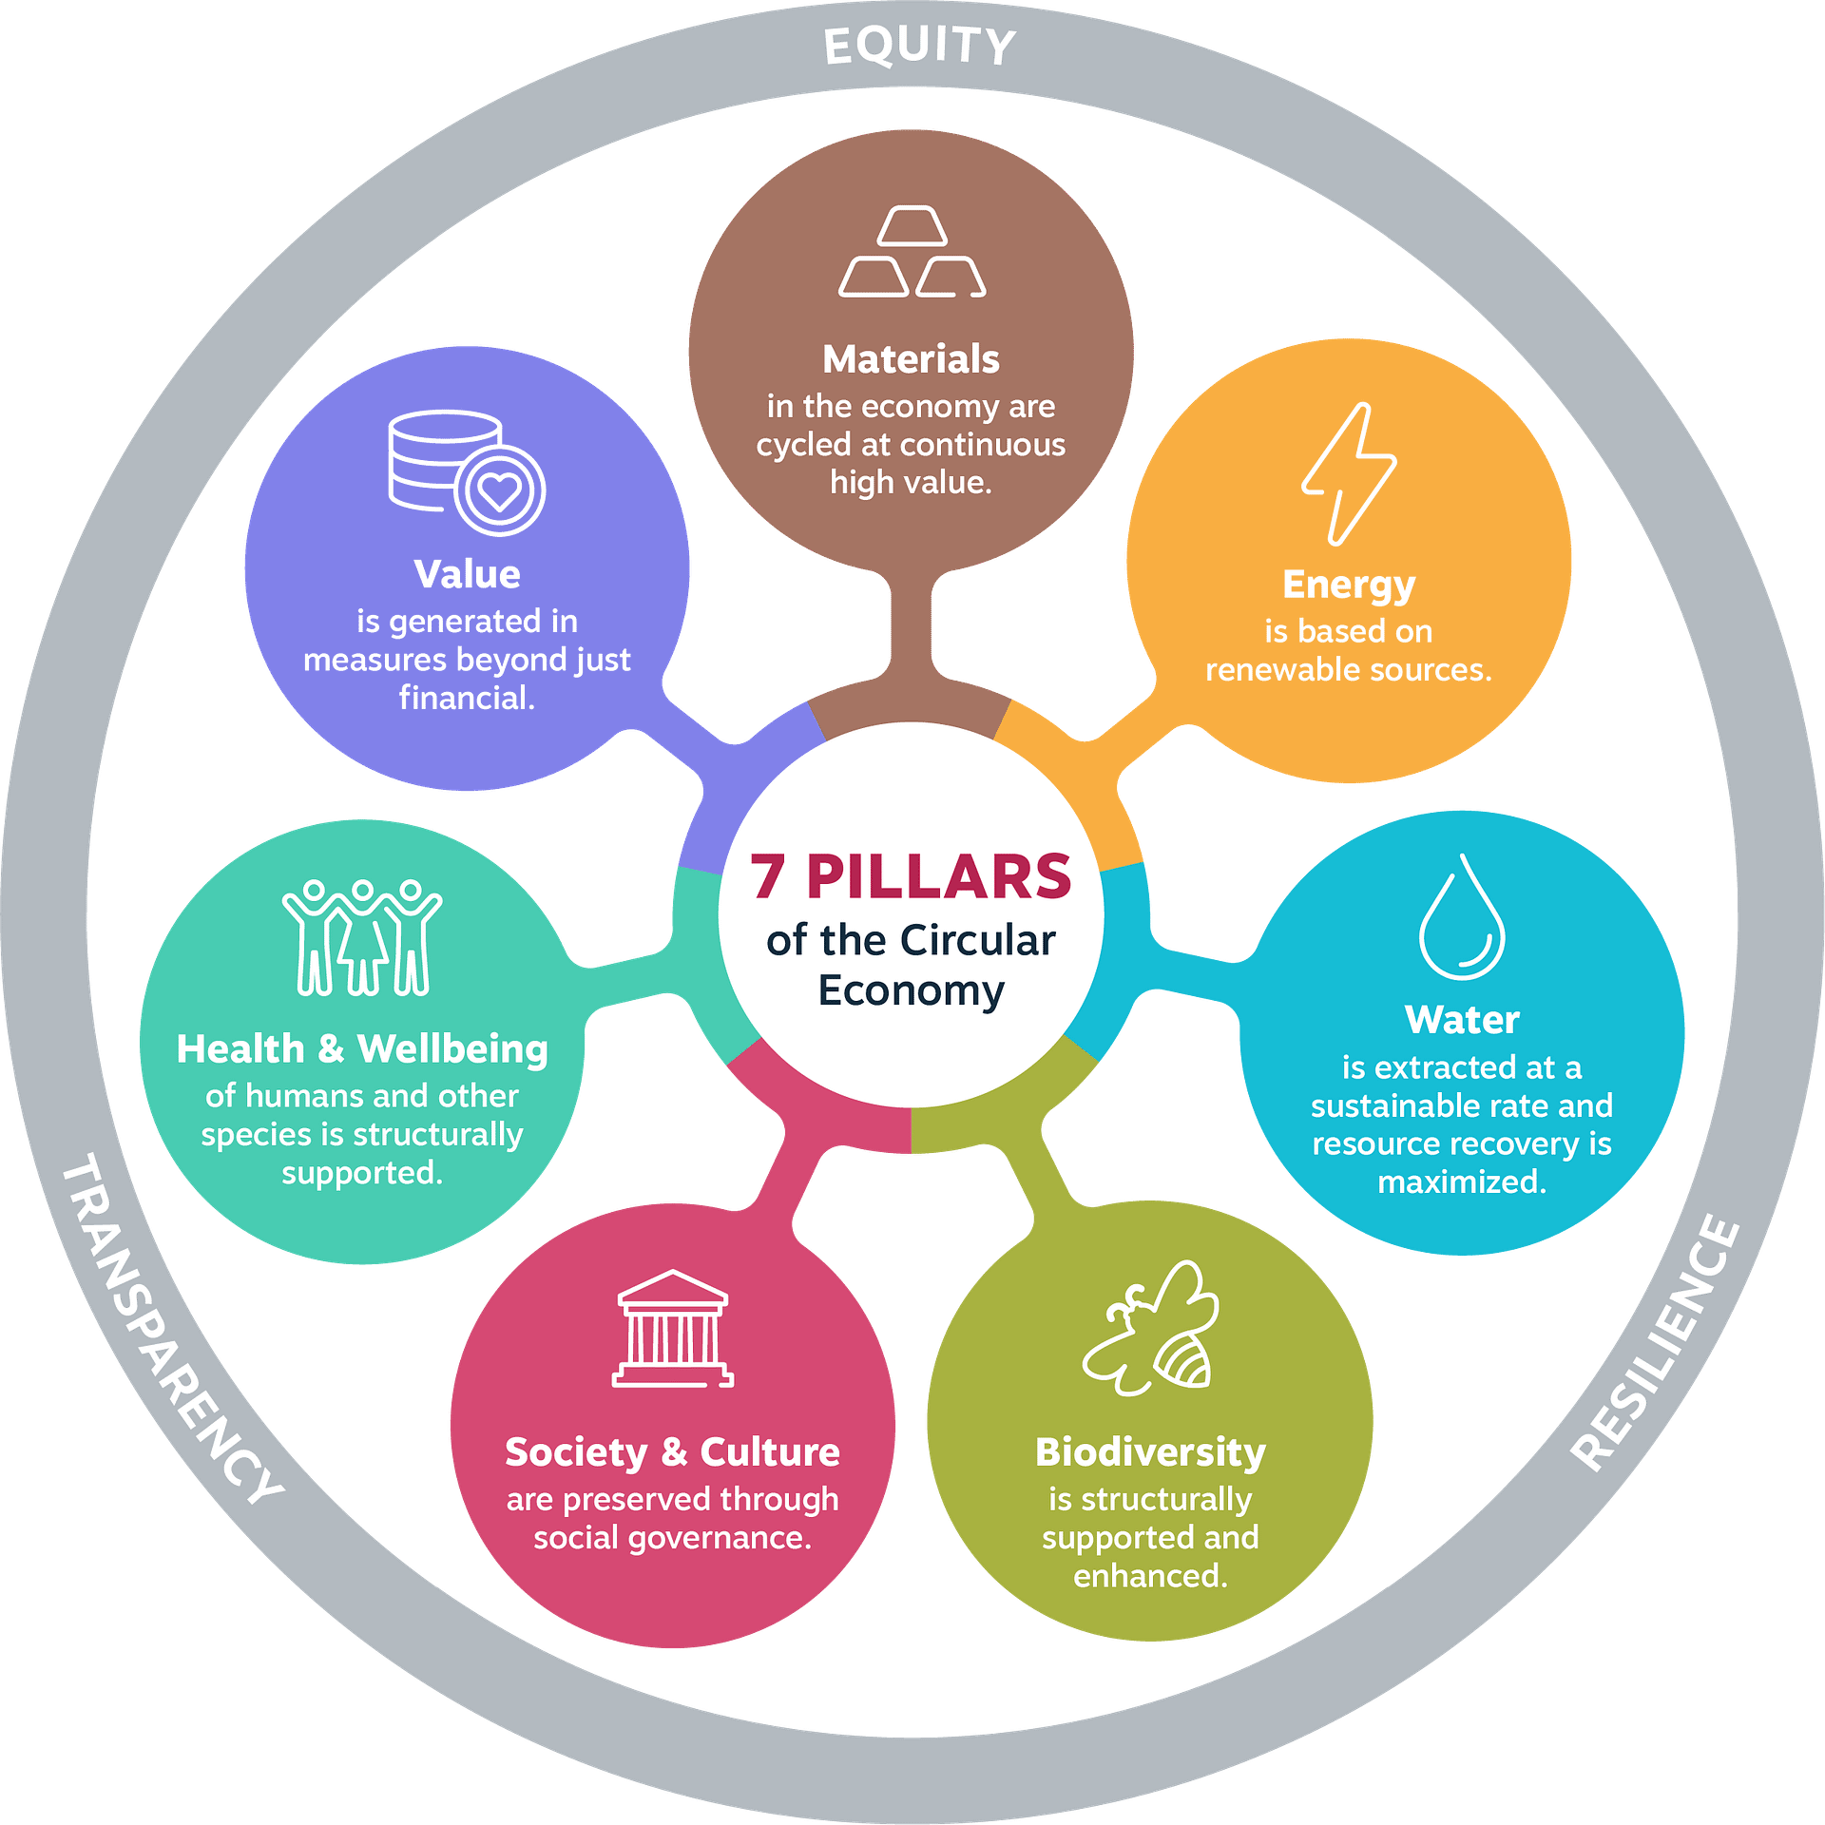

A (common) vision?
Notes:
Principles, pillars, levers

Slide 28
A (common) vision?

Slide 29
1. Design Out Waste and Pollution
Key Idea: Waste and pollution result from design flaws
Goal: Eliminate waste at the source.
Strategies:
Innovative Design: Create products and systems to minimise resource loss
Non-Toxic Materials: Use safe, sustainable inputs
Efficient Processes: Optimise production to reduce emissions and waste
Focus: Prevent waste instead of managing it

Slide 30
2. Keep Products and Materials in Use
Key Idea: Maximise the value of products and materials 👉 keep in use
Goal: Extend product life & reduce waste
Strategies:
Durability: Design products to last longer
Reuse and Repair: Encourage reuse, repair, and refurbishment
Remanufacturing and Recycling: Reintroduce materials into the economy after use
Sharing Models: leasing, sharing, or product-as-a-service
Focus: Shift from “take-make-dispose” to a circular flow of resources

Slide 31
3. Regenerate Natural Systems
Key Idea: Enhance & restore ecosystems
Goal: Promote practices that replenish natural resources
Strategies:
Renewable Resources: renewable energy & sustainable materials
Ecosystem Restoration: Support biodiversity, soil health, and water cycles
Biological Cycles: Design for composting & natural decomposition
Focus: 👉 from extractive to regenerative processes

Slide 32
But how: Arrrrr!

Slide 33
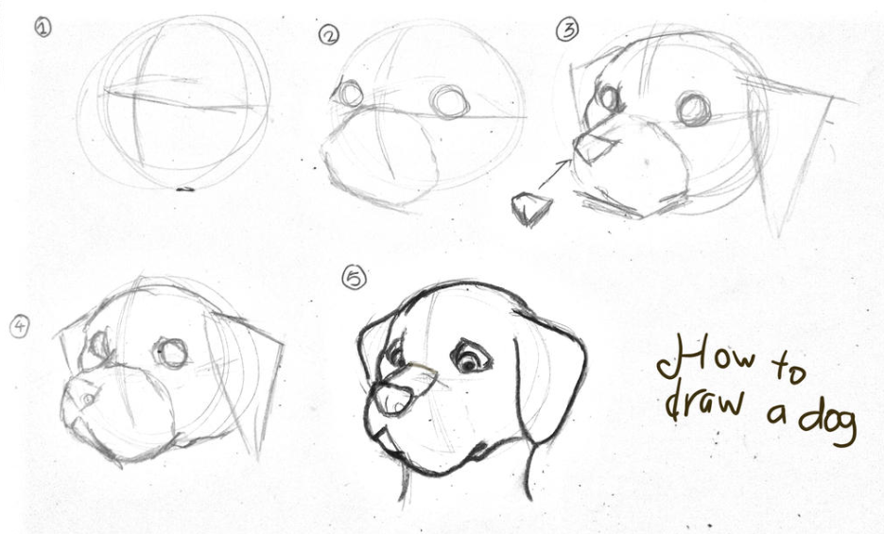
But how?

Slide 34
The EU (2008) 4R Waste Framework Directive
Reduce:
Minimize the use of resources and energy in production
Design products with fewer materials, prioritize efficiency
Reduce environmental footprint by limiting waste
Reuse:
Extend product life: using items multiple times
Encourage repairing, refurbishing, and reusing products
Supports a to durable, reusable products
Recycle:
Process waste materials into new products, reducing the need for virgin resources
convert used items back into raw materials
proper sorting and recycling infrastructure
Recover:
Recover energy or materials from waste
incineration or composting of organic waste
Aims to extract as much value as possible from remaining waste materials

Slide 35
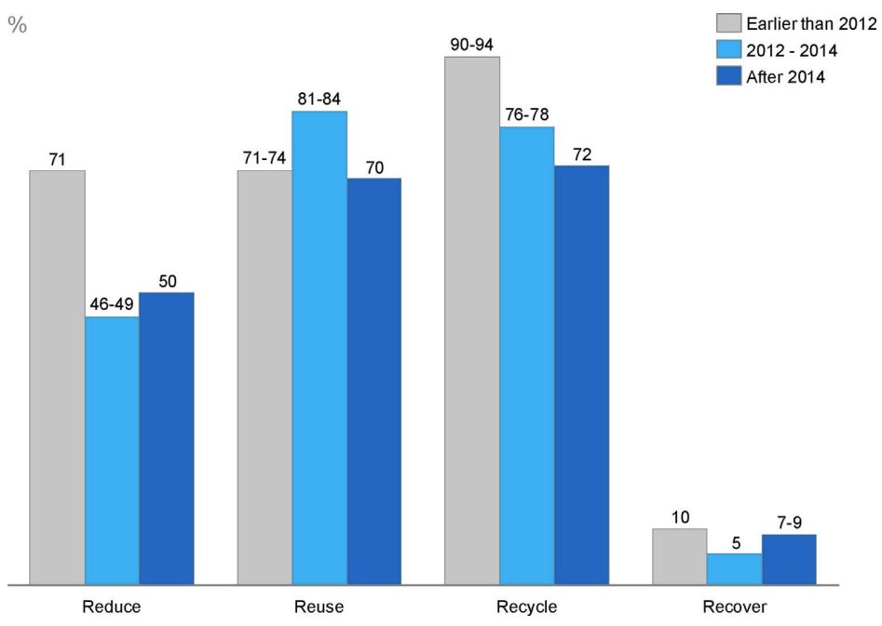
Core circular principles
👉 R-Frameworks: 3, 4, 6 & 9R
System-Frameworks: Localisation of transition
Hierarchy
Notes:
MacArthur:
Eliminate waste & pollution
Circulate products & materials (at their highest value)
Regenerate Nature

Slide 36
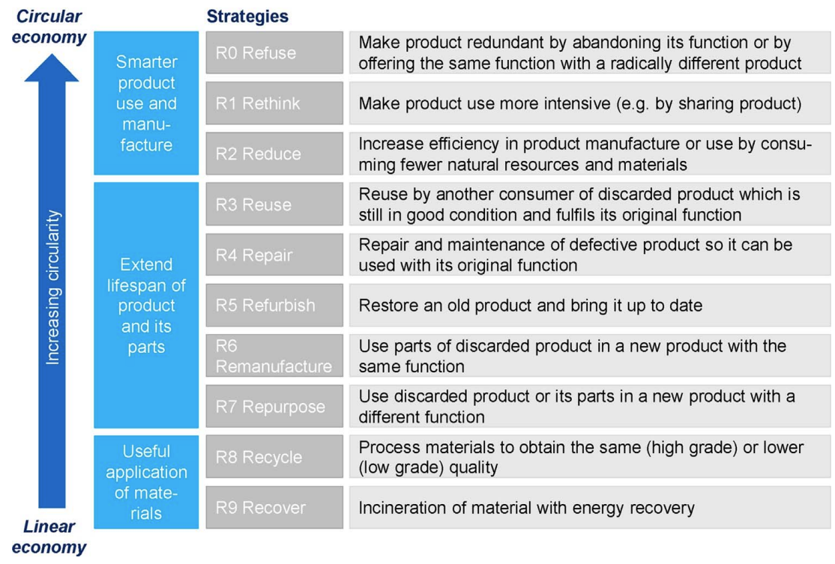
9Rs according to Potting et al. (2017):

Slide 37
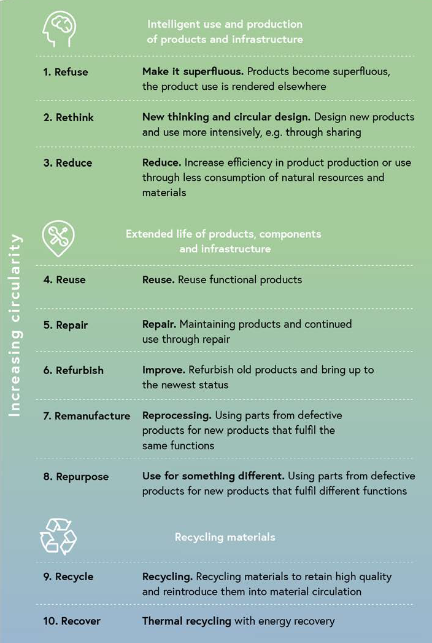
And in Austria we have 10 😉

Slide 38
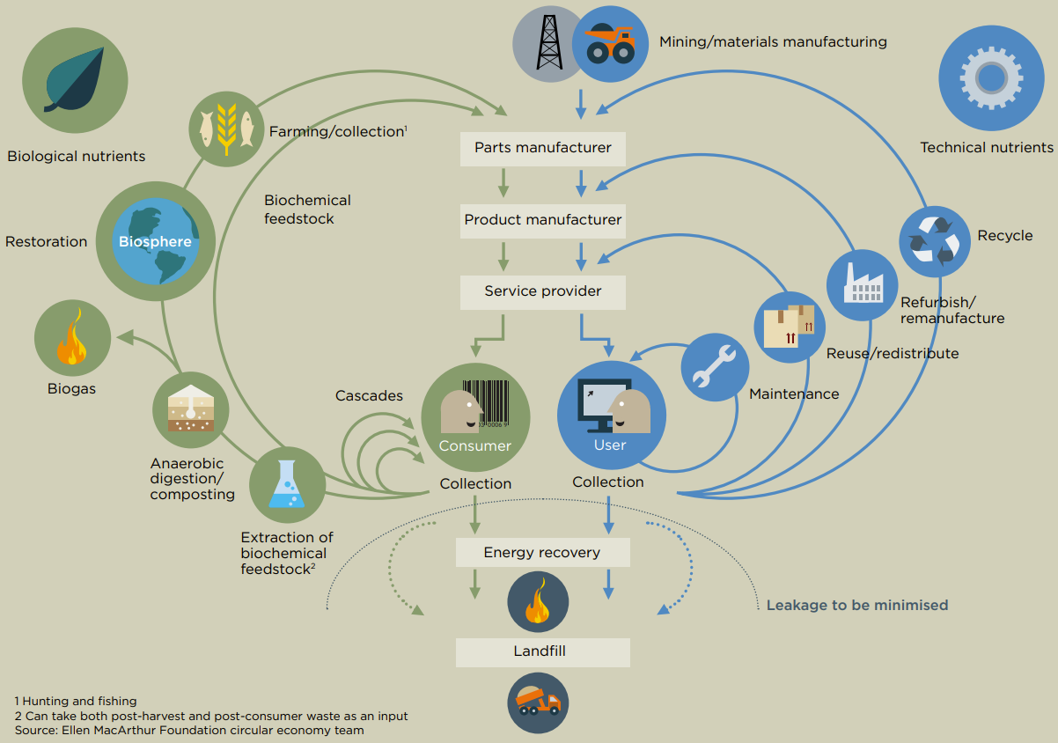
The iconic “Butterfly Diagram”:
Notes:
Linear: Take – make – waste
80% environmental impact from insufficient design (EC, 2020:3)
Walter Stahel: 1982 „closed loop economy“
2013: Ellen MacArthur Foundation Vol. 1
3R: 2008 Circular Economy Promotion Law of the People’s Republic of China
MacArthur:
Eliminate waste and pollution
Circulate products and materials (at their highest value)
Regenerate Nature

Slide 39
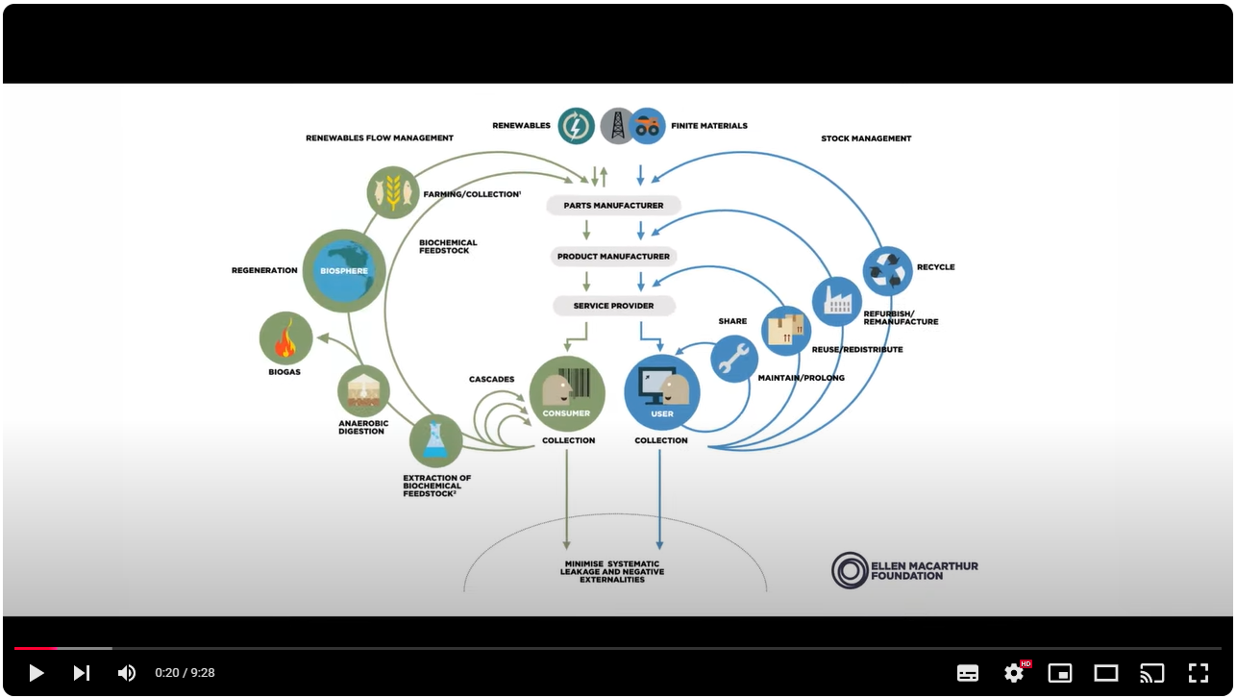
Let’s listen to Ellen MacArthur herself:

Slide 40
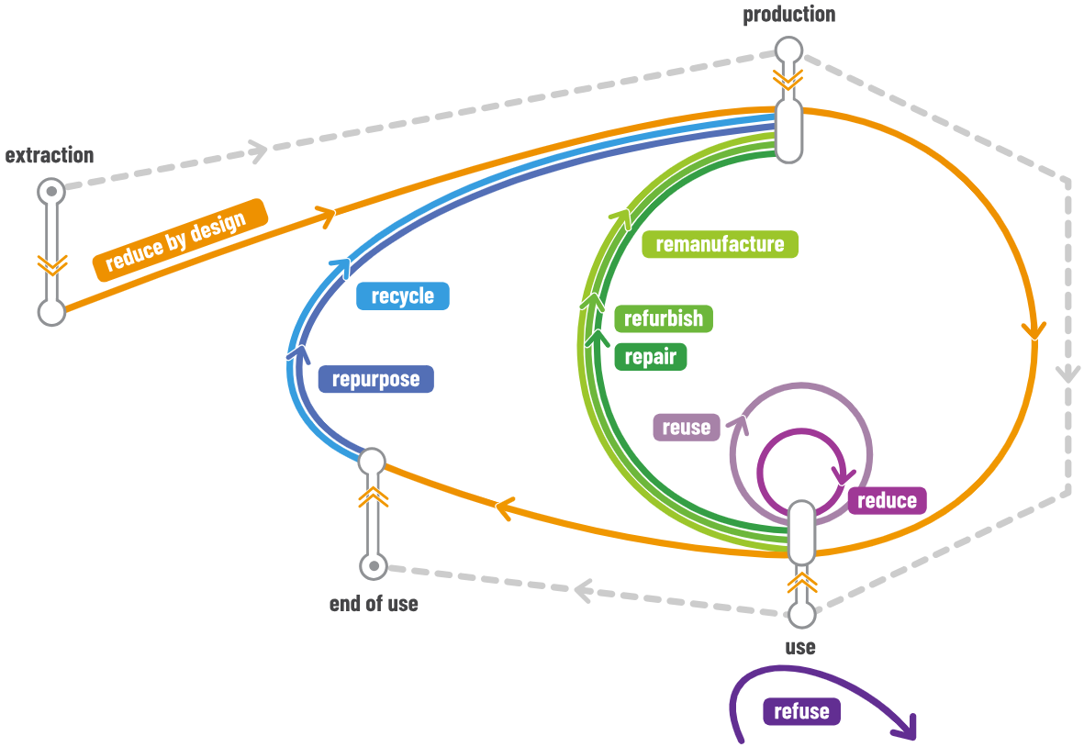
An alternative: UNEP’s (2023) circularity approach
Notes:
Linear: Take – make – waste
80% environmental impact from insufficient design (EC, 2020:3)
Walter Stahel: 1982 „closed loop economy“
2013: Ellen MacArthur Foundation Vol. 1
3R: 2008 Circular Economy Promotion Law of the People’s Republic of China

Slide 41
An alternative: UNEP’s (2023) circularity approach
Notes:
Linear: Take – make – waste
80% environmental impact from insufficient design (EC, 2020:3)
Walter Stahel: 1982 „closed loop economy“
2013: Ellen MacArthur Foundation Vol. 1
3R: 2008 Circular Economy Promotion Law of the People’s Republic of China

Slide 42




1. Reduce
Refuse: make product redundant
Rethink: more intensive use 👉 sharing
Reduce: minimize material flows
Notes:
* Sharing: per2per, cooperatives, peer2b2peer, b2b,

Slide 43
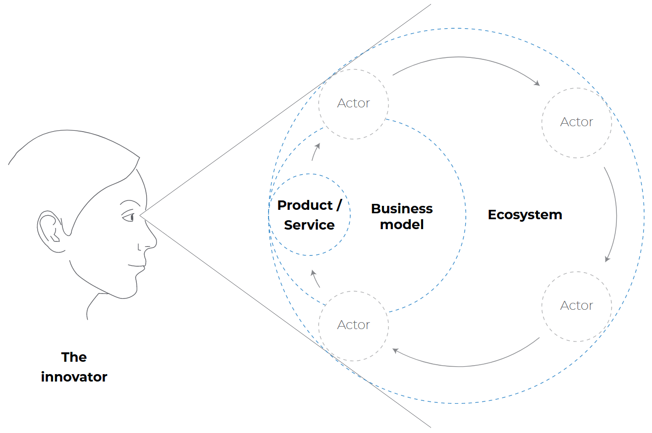
@ Refuse:
„A circular economy cannot be achieved by market forces alone, particularly when the market framework does not fully internalise external costs. Hence the necessary change here requires comprehensive policy frameworks that make use of the power of the market economy, but with revised rules.” (Fröhling et al. 2022)

Slide 44

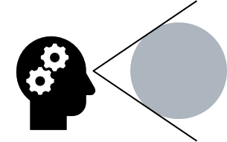

@ Refuse :

Slide 45
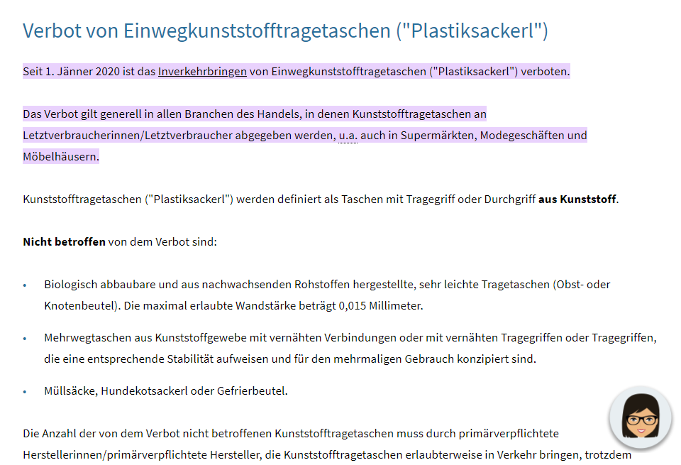
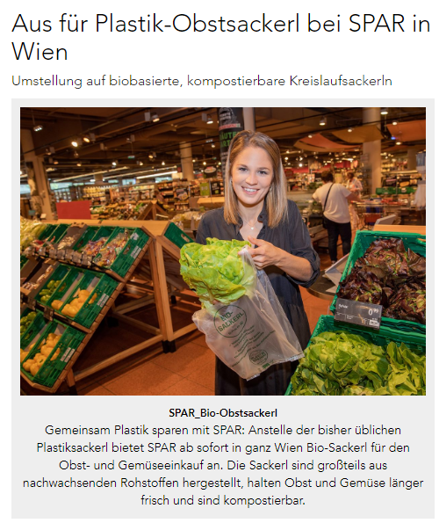
@ Refuse: Top Down
Notes:
§§ 13j bis 13m Abfallwirtschaftsgesetz (AWG)

Slide 46
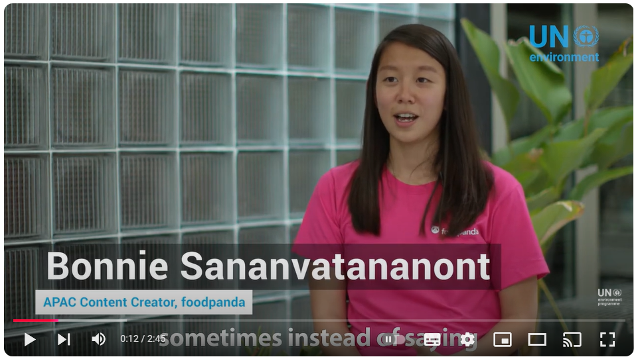
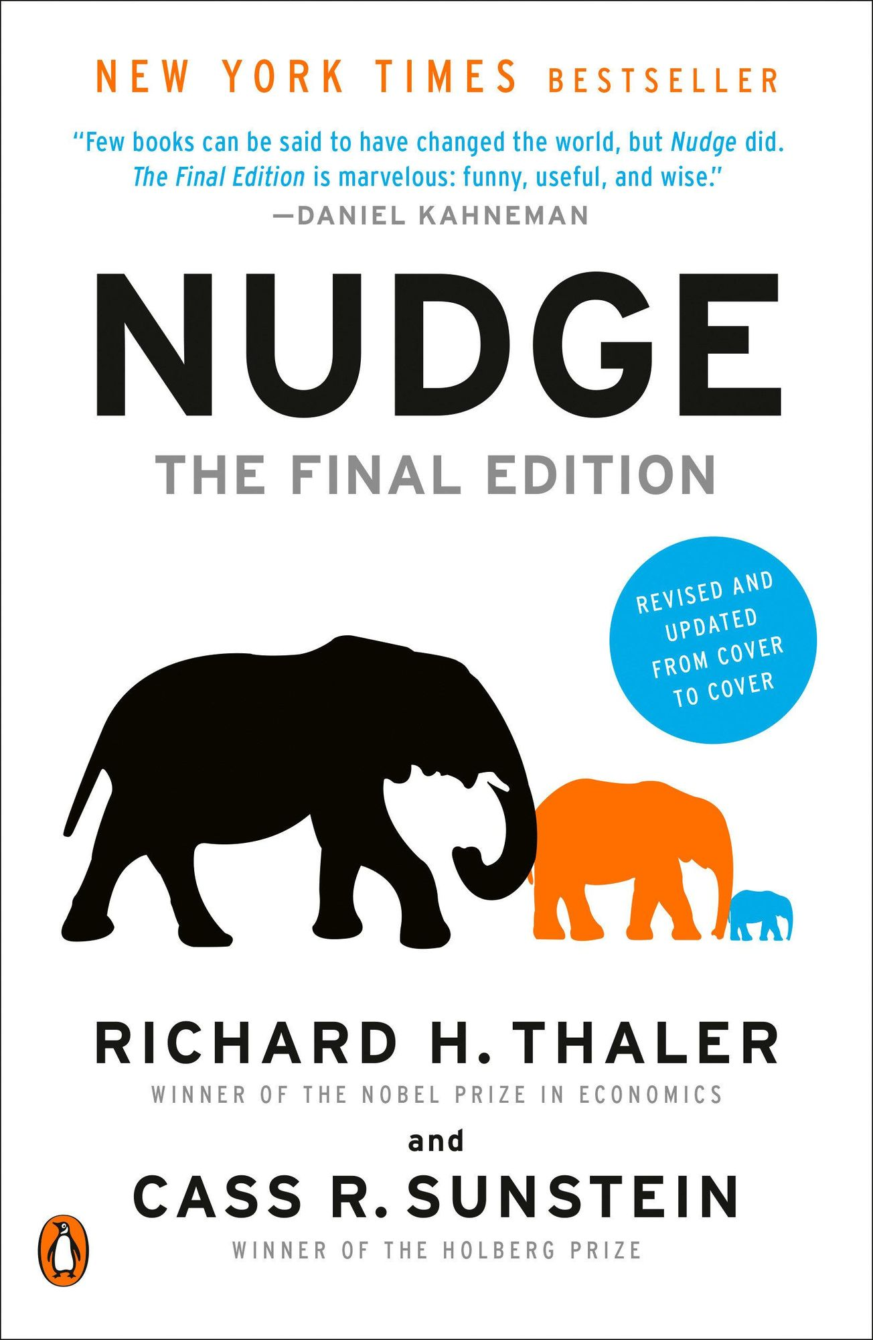
@ Refuse: Bottom Up
Notes:
§§ 13j bis 13m Abfallwirtschaftsgesetz (AWG)

Slide 47
1. Reduce
Refuse: make product redundant
Rethink: more intensive use 👉 sharing
Reduce: minimize material flows
Notes:
* Sharing: per2per, cooperatives, peer2b2peer, b2b,

Slide 48
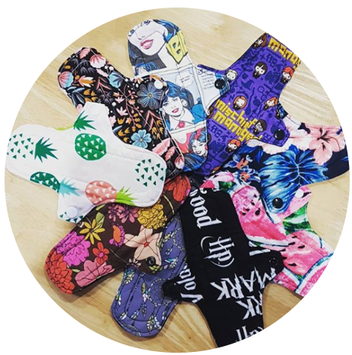


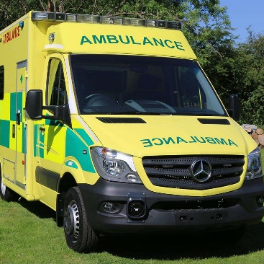

2. Reuse
Reuse: discarded products
Repair & Maintenance: defect products
Refurbish: restore old products
Remanufacture: integrate discarded parts
Repurpose: new product & function
Notes:
reuse: amrican Samoa – reusable sanitary pads – feminine hygene products: 6 against 900 disposable
Repair/maintain: planned obsolescence
Refurb / remanu: DLL dutch refurbishing ambulances NHS
Repurpose: Feinix textile recycling Philipines surplus fabrics from garment factroies to bags & shoes
Lorry tarpaulin

Slide 49
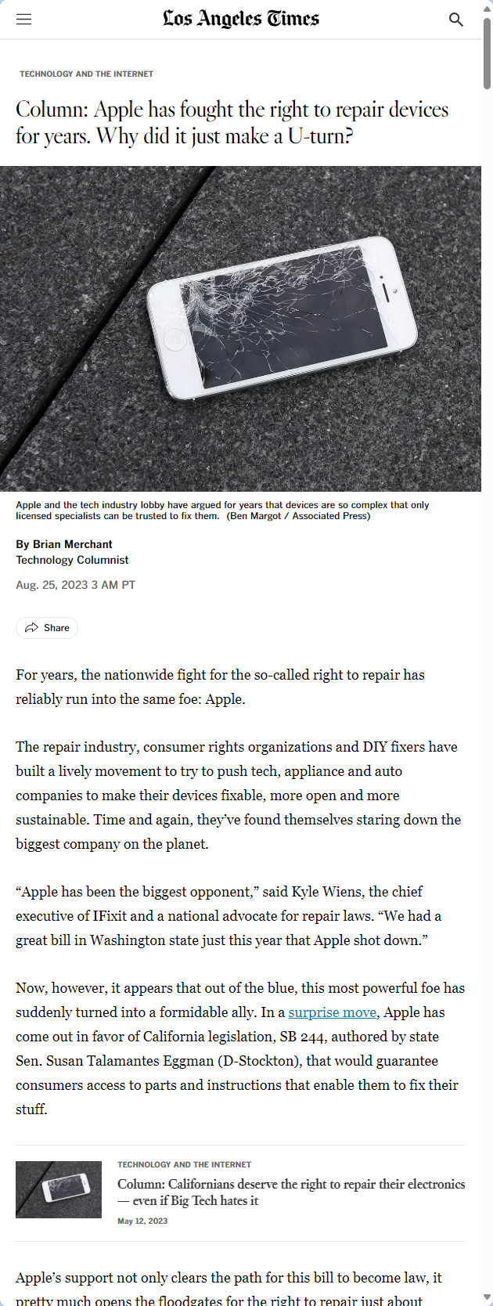
@ Repair:

Slide 50
@ Repair:

Slide 51

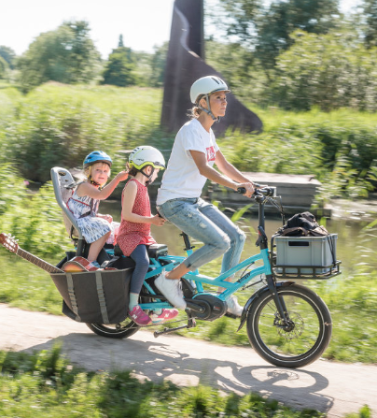
@ Repair: V1 Selber machen lassen!

Slide 52
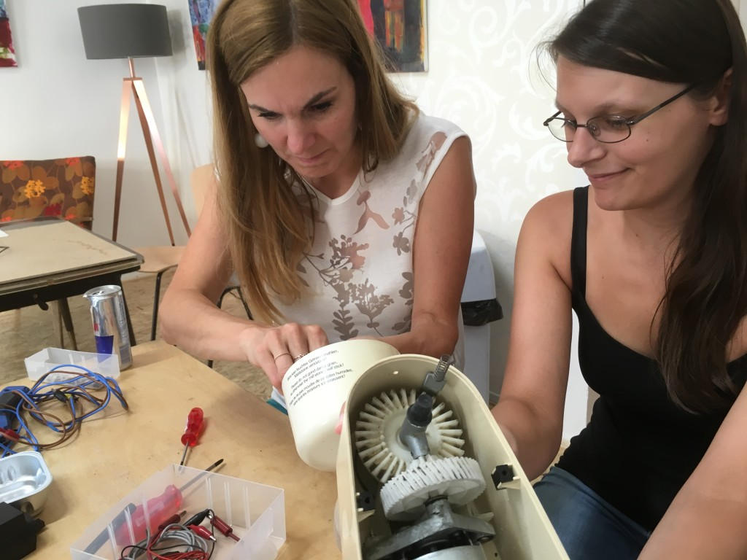
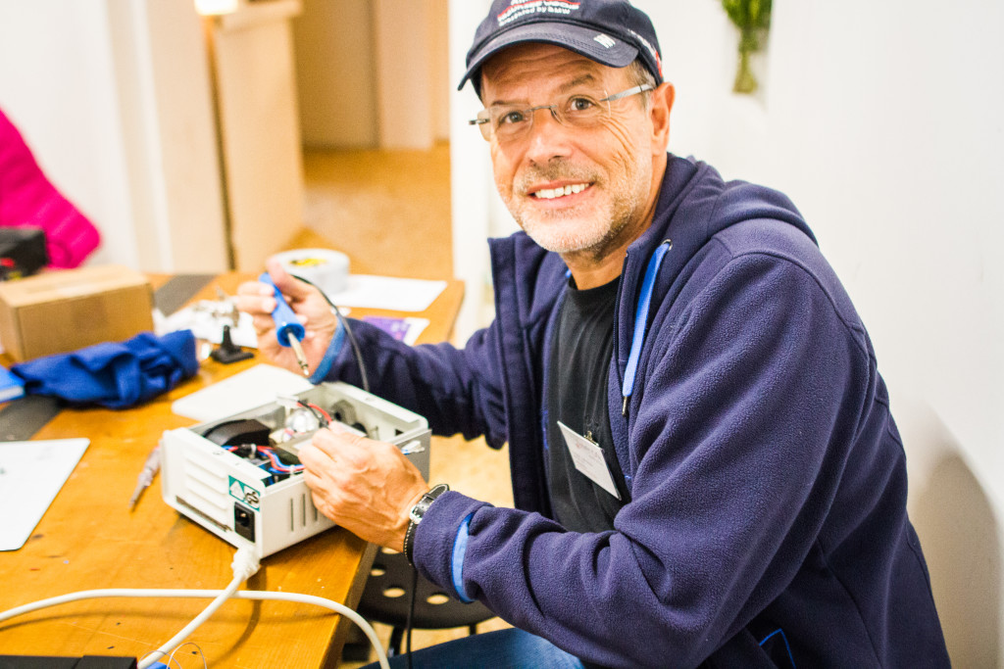
@ Repair: V2 Selber machen lassen!

Slide 53
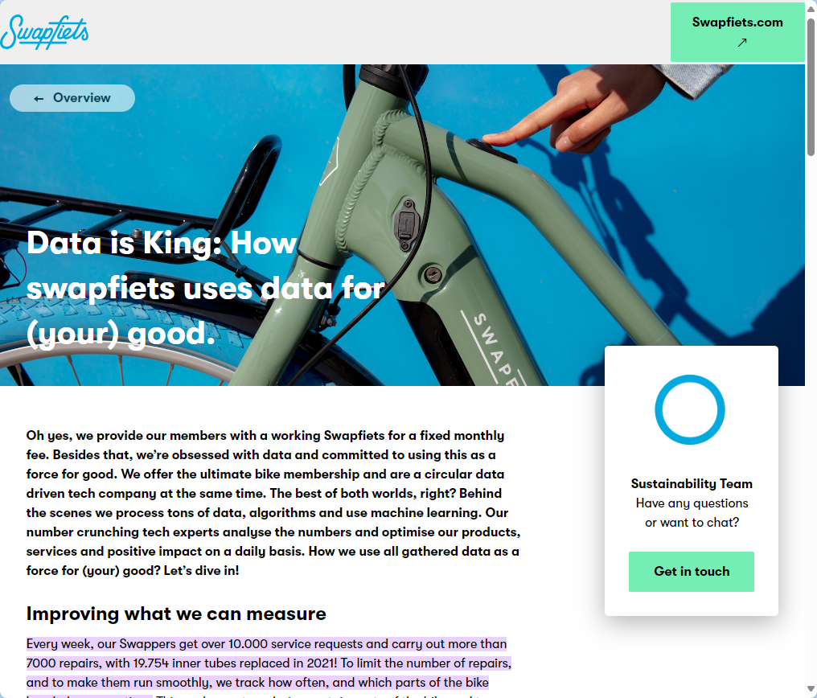
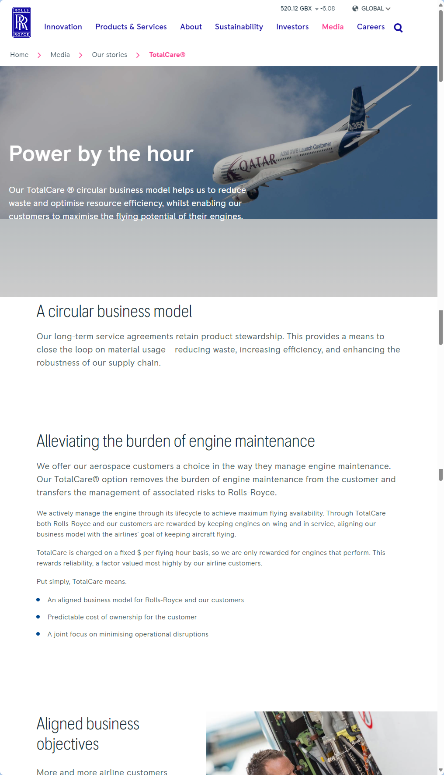
@ Repair: V3 service with predictive maintenance
USD 20 Billion
Notes:
Swapfiets:
250.000 members in the Netherlands, Germany, Belgium, Denmark, France, Italy, and the UK in early 2021
Every week, our Swappers get over 10.000 service requests and carry out more than 7000 repairs, with 19.754 inner tubes replaced in 2021!
===========================
Since 1962: Performance based contracts
Market size Rolls Royce: USD 20 Billion

Slide 54
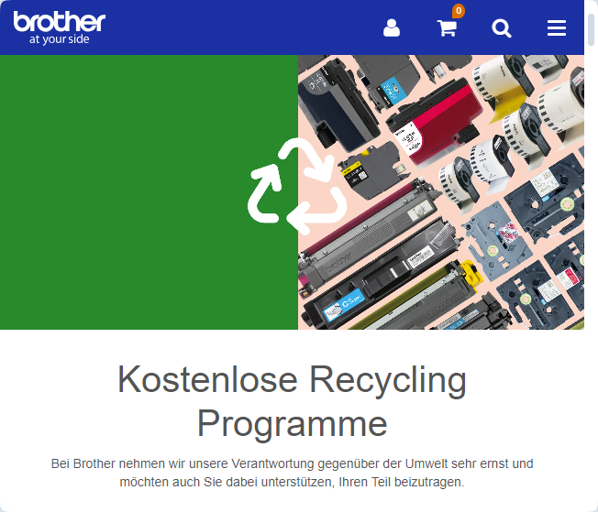
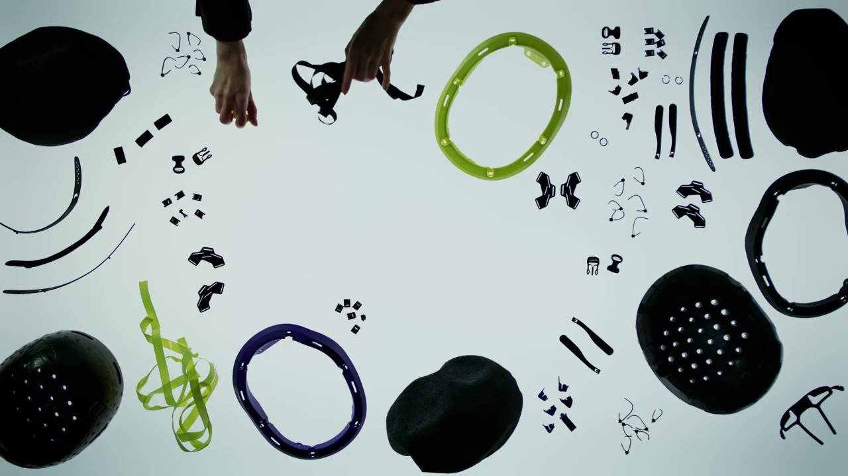
3. Recycle
Process materials to same or lower quality
👉 refurb, remanufacture
👉 reduce

Slide 55
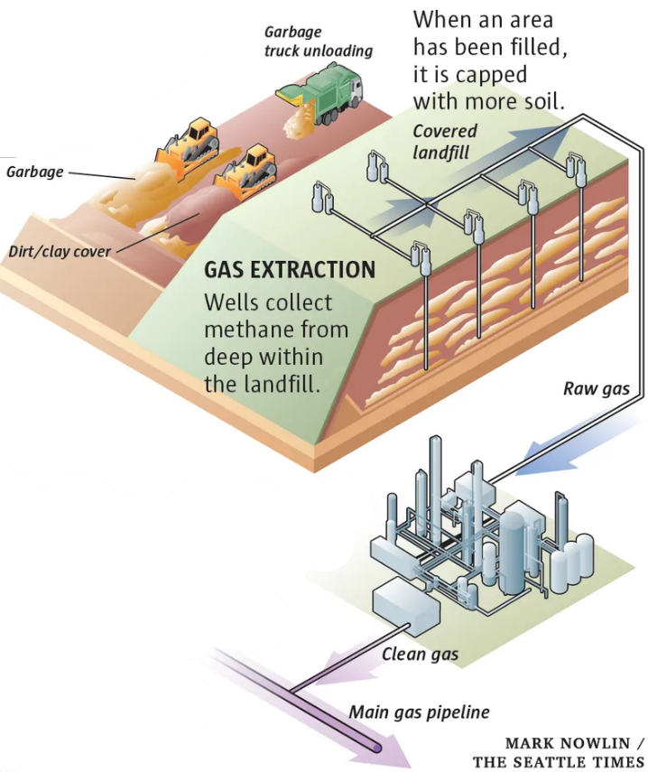
4. Recover
Incineration & energy recovery
Final storage
Methane management
Notes:
When life gives you lemons, make lemonade

Slide 56
Wait, my phone …

Slide 57

… & then?

Slide 58

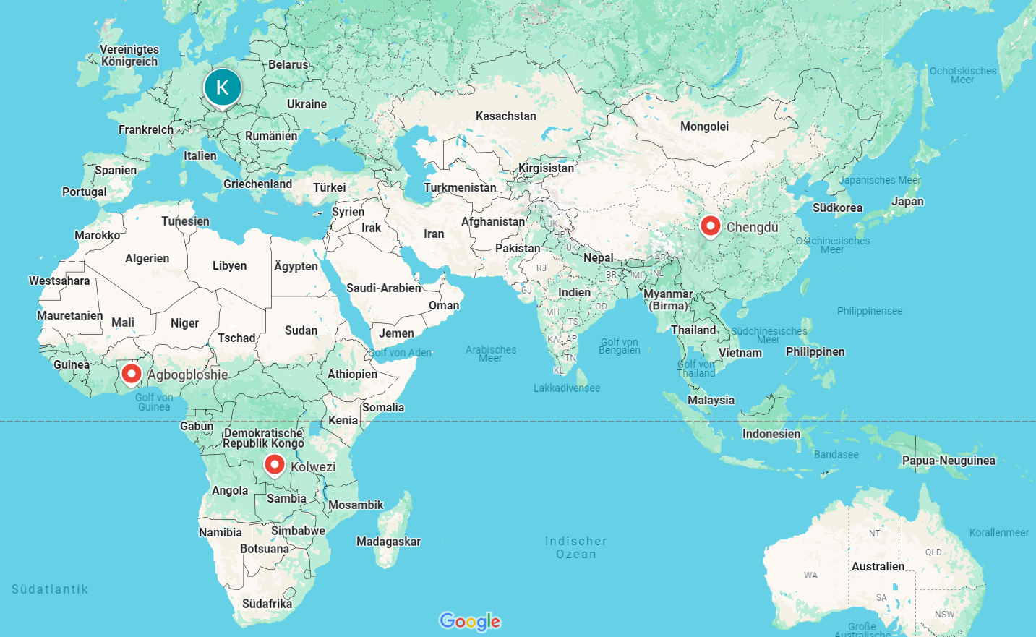
Me & my smartphone …
Notes:
Kolwezi, Democratic Republic of Congo
Chengdu, People Repuclic of China
Krems, Austria
Agbogbloshie near center Accra, Ghana

Slide 59

… & then?

Slide 60
From linear to circular strategies:

Slide 61
Some reflections

Slide 62


Which R is most important?

Slide 63



A critical outlook: Does or will it work?
No: from a thermodynamic perspective
Yes: Sector specific activity levels
🔎 Consumer goods
Challenges:
Definitional quagmire
Business as usual
Rebound effects
Apolitical nature
Notes:
Quarrying: open pit - S&s & gravel

Slide 64
Why not? Strands of critique 1/2
Theoretical Critiques:
Lack of clear definition 👉 conceptual fragmentation
Neglect of thermodynamic limits
Practical Critiques:
technical, economic, and regulatory barriers 👉 limited implementation
Over-reliance on technology

Slide 65
Why not? Some theoretical critiques
Definitional Ambiguity:
Lacks a universally accepted definition👉 conceptual fragmentation
Repackaged Ideas:
Reuses older concepts without significant innovation
Neglect of Biophysical Limits:
Ignores thermodynamic realities 👉 perfect circularity = unattainable
Entropy & material dissipation
Simplistic Assumptions:
failing to address hazardous waste, contamination & resource limitations

Slide 66

Digression: Thermodynamics?
👉 branch of physics:
Relationships between heat, energy & work
Energy transfer & transformation in systems
Earth = closed thermodynamic system
Energy Exchange: sun & radiation
Matter Exchange: negligible exchange
meteors entering or gases escaping to space

Slide 67
@Neglect of Biophysical Limits:
2. Law of thermodynamics:
in any energy transfer or transformation, the total entropy (disorder) of a system will always increase over time, or at best, remain constant
Entropy & material quality:
High-quality, usable materials = low entropy (“ordered”)
During use, processing or recycling: mixes 👉 increase entropy
Entropy & inevitable losses:
Production, use, recycling 👉 wear, corrosion, contamination

Slide 68


@Neglect of Biophysical Limits:

Slide 69
Why not? Strands of critique 2/2
Ideological Critiques:
Focus on technical solutions 👉 sidelining social justice
Unproven assumption of “Green Growth”
Corporate dominance & “Rebound Effects”
Ethical and Social Oversights:
Little attention to equity, inclusion & power dynamics
Little attention to Global South & informal waste sectors
Little attention to winners & losers

Slide 70


@ Ideological critiques
“CE has been conceptualized as an ecological modernization project that builds on capitalist economic growth narratives” (Jaeger-Erben et al., 2021:105475)
Notes:
ecological modernisation project
"which continues to be based on a capitalist interpretation of progress and economic growth."

Slide 71

@ Ideological critiques

Slide 72
A critical outlook: Does or will it work?
No: from a thermodynamic perspective
Yes: Sector specific activity levels
🔎 Consumer goods
Challenges:
Definitional quagmire
Business as usual
Rebound effects
Apolitical nature
Notes:
Quarrying: open pit - S&s & gravel

Slide 73

@ 🔎 consumer products
Notes:
Quarrying: open pit - S&s & gravel

Slide 74

Conclusion: Our understanding of development is too resource intense

Slide 75
Let’s do it!

Slide 76

Let’s give Konietzko’s (2020) Circularity Deck a try

Slide 77

Konietzko’s (2020) Circularity Deck:

Slide 78
Konietzko’s (2020) Circularity Deck:
1) Narrow: use less material & energy during design, production, delivery & use
2) Slow: use products, components & material longer
3) Close: Use wasted products, components & materials again
4) Regenerate: Use non-toxic & biodegradable materials & renewable energy
5) Inform: Use information technology to narrow, slow, close & regenerate material & energy flows

Slide 79
Here we go:
Form 4 groups of ~5

Slide 80



Our products:
G1
G2

Slide 81


Our services:
G3
G4

Slide 82
Here we go:
Form 4 groups of ~5
Distribute principles
Have a look at the cards
Figure out & discuss if and how each card might help to make the product/service more circular

Slide 83
Here we go:
Document your findings in notes:
G1: https://miro.com/app/board/uXjVL7j-fW8=/?share_link_id=796996861112
G2: https://miro.com/app/board/uXjVL7j2tFg=/?share_link_id=7292586673
G3: https://miro.com/app/board/uXjVL7j2t-Y=/?share_link_id=160076667403
G4: https://miro.com/app/board/uXjVL7j2t6k=/?share_link_id=900185609792

Slide 84
Wrap it up

Slide 85
Wrap it up
Linear production & consumption patterns dominated so far
👉 Non-sustainable resource use
Circular economy:
3 main principles: less, longer & regenerative
follows at least 4 Rs: Reduce, Reuse, Recycle, Recover (Arrr!)
beyond classic understanding of "business“
Theoretical & practical critique 👉 asymptotic ideal
Ideological & ethical critique 👉 Circular Economy as subset of a Circular Society

Slide 86

Till next session:
https://youtu.be/Cvh7p6IehSo

Slide 87


So long & cheerio!

